Slide 1
Visual C# Applications

Slide 2
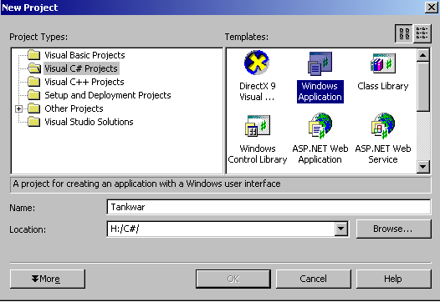
To use the visual environment select:
Visual C# Projects
Windows Application

Slide 3
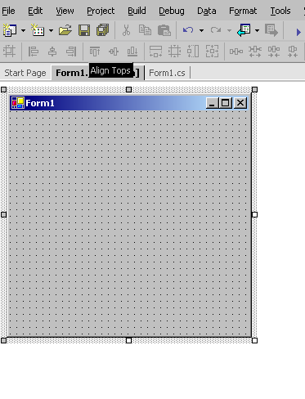
The form is used to create the visual aspects of the project.
Onto this we will place controls such as images.

Slide 4
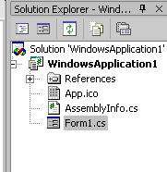
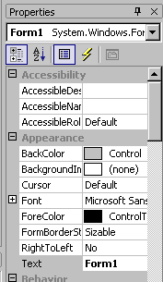
Above the properties window you will see the solution explorer.
This shows the files that are contained in the project, for example Form1.cs.
select the view menu followed by properties window. You should see the properties window on the right of your screen. The properties window will show the properties of the selected object. In the example here it is the properties of the form that are seen.

Slide 5
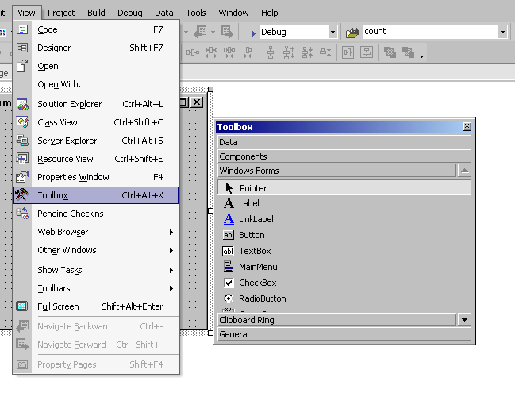

To place controls on the form use the Toolbox.

Slide 6
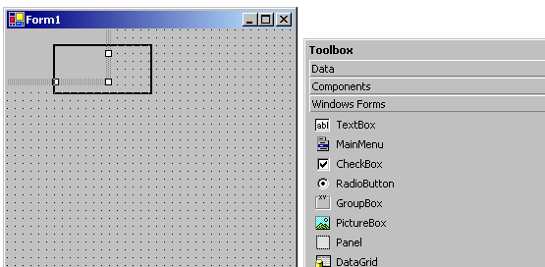
Click and drag the control to the position that you want it.

Slide 7
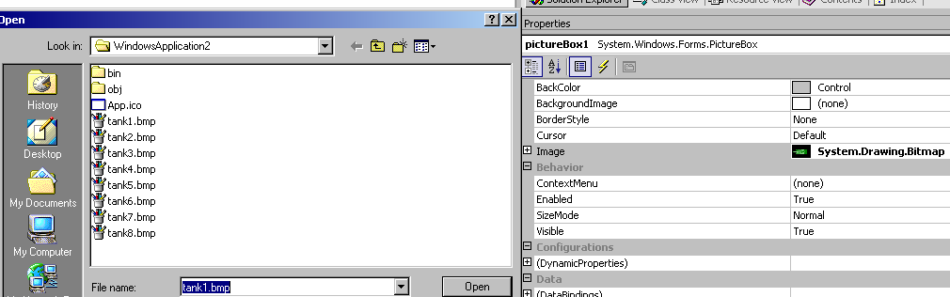
We will now use the properties to get the image.
Select the pictureBox and the properties window will show the properties for the pictureBox. Select the image property and you will be presented with a dialogue box from which you can navigate to and select an image.

Slide 8
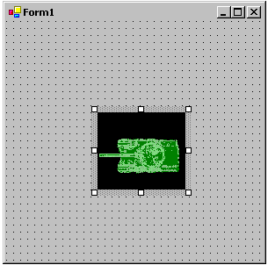
Place an image control on the form.
Set the properties.

Slide 9
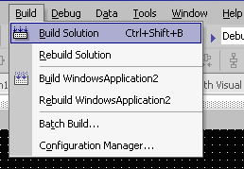
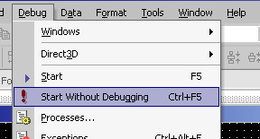
To run the project
Build the solution
Start the program

Slide 10
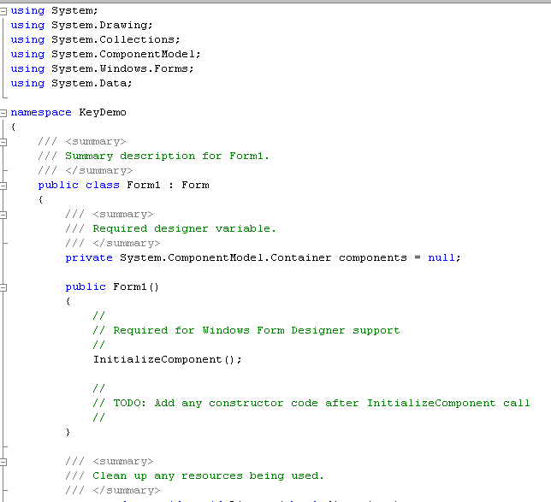
The generated code

Slide 11
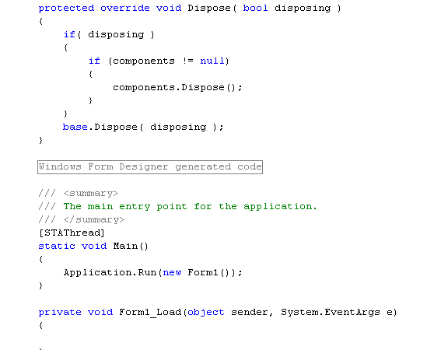

Slide 12
Traffic Light Example

Slide 13
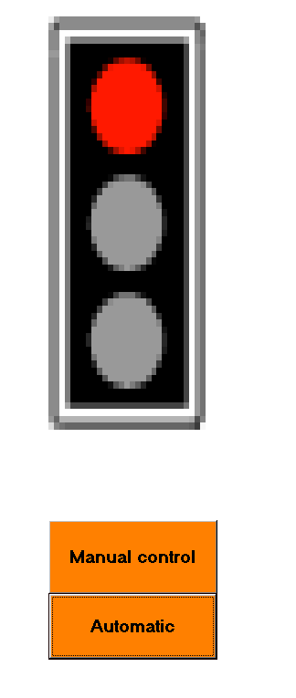

Slide 14
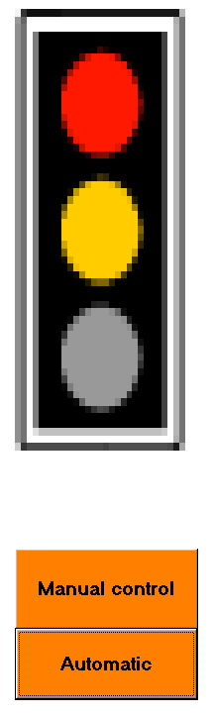

Slide 15
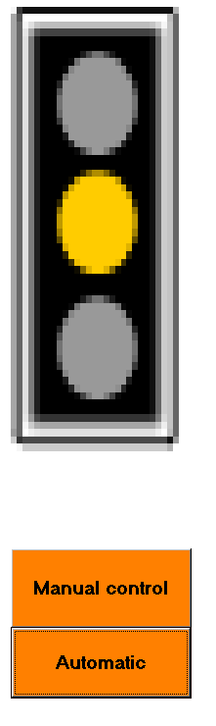

Slide 16
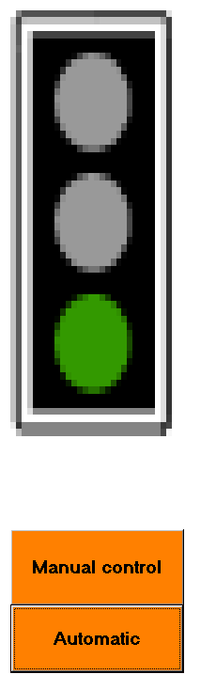

Slide 17
Place a single image control on the form.
The image that is viewed is replaced with code in a loop that simulates the changing of the traffic lights.
pictureBox1.Image = Image.FromFile("E:/signs01.bmp");

Slide 18
Within the loop there is a selection statement to simulate the changing of the lights i.e. replace an image depending on the previous:
If red then replace with red/amber picture
…
Initially this can be done with a button click i.e. each time the button is clicked the light should change.

Slide 19
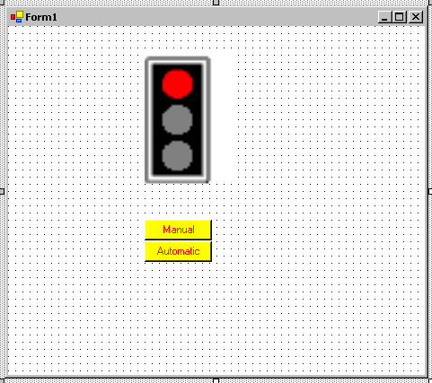
Making it automatic
Image
control
buttons
Add a timer control from the Toolbox.

Slide 20

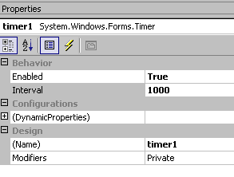
The timer control doesn’t appear on the form but you will find the icon above the output window. Click on this to show properties.
Two important properties:
Enabled – True, switches the times on, false switches off
Interval – set the time in milliseconds for the code associated to execute e.g. if set to 1000 milliseconds the code associated will execute each and every second.

Slide 21
Traffic Lights Sample code
G.Affleck

Slide 22
Pseudocode:
If nextlighton is 1 Then
Load picture 1
Else if nextlighton is 2 Then
Load picture 2
Elseif nextlighton 3 Then
Load picture 3
Else if nextlighton 4 Then
Load picture 4
After loading the light we need a way to signify the next light to go on.

Slide 23
Automatic Function
If nextlighton is 1 Then
Load picture 1
set nextlighton to 2
If nextlighton is 2 Then
Load picture 2
Set nextlighton = 3
If nextlighton is 3 Then
Load picture 3
set nextlighton = 4
If nextlighton is 4 Then
Load picture 4
nextlighton = 1

Slide 24
This code is used for both manual and automatic routines
I++;
if (I == 1)
pictureBox1.Image = Image.FromFile("E:/signs01.bmp");
if (I == 2)
pictureBox1.Image = Image.FromFile("E:/signs02.bmp");
if (I == 3)
pictureBox1.Image = Image.FromFile("E:/signs03.bmp");
if (I == 4)
{
pictureBox1.Image = Image.FromFile("E:/signs04.bmp");
I = 0;
}
Alternatively use a switch statement:

Slide 25
switch (I) {
case 1:
pictureBox1.Image = Image.FromFile("E:/signs01.bmp");
I = 2;
break;
case 2:
pictureBox1.Image = Image.FromFile("E:/signs02.bmp");
I = 3;
break;
case 3
pictureBox1.Image = Image.FromFile("E:/signs03.bmp");
nextlighton = 4;
break;
case 4:
pictureBox1.Image = Image.FromFile("E:/signs04.bmp");
nextlighton = 1;
break;
}

Slide 26
The problem of scope:
We need a variable that will keep a count of the image number i.e. first light image , second, third and 4
int I;
This would be used by both manual and automatic
Therefore need to be available to both – a class wide variable that can be used by both functions

Slide 27
Scope 1
In C#

Slide 28
The need for a variable to hold a value may be:
1. Throughout the class i.e. class wide.
2. Local to a function.

Slide 29
By default all variables declared within a form are private variables.
These private variables are private within the block of code in which they are declared.
What is a block of code?
class-wide variable are those that are declared outside of any function and can be referenced from anywhere within the class i.e. they are global to the class.
Block level1
Program-Wide
Block level 2
Function 1
Identifiers declared at the function level can be referenced within the function but not outside it, in this case within function 1.
Block level 2
Function 2
Identifiers declared in another function can only be referenced within that function i.e in this case function 2

Slide 30
Block Level 2
private void myfunc(){
{
int J;
J = 5;
}
J
At the second line
int J;
space is reserved in memory .

Slide 31
Block Level 2
private void myfunc(){
int J;
J = 5;
}
Before the function ends J is assigned the value 5
J
5

Slide 32
Block Level 2
However at the end of the function signified by } any identifiers declared within the function are local to that function and only exist within that function therefore they lose context (are destroyed) and cannot be referenced from any other function.
private void myfunc(){
int J;
J = 5;
}
Therefore the variable J is declared within the function and as such only exists as long as the function is being executed.

Slide 33
Block Level 1
Class Wide Identifiers
int anywhere;
Class wide Variables
private void myfunc ( )
{
int onlyhere;
Local functionVariable
….
}

Slide 34
namespace VisualLab1
{
public class Form1 : System.Windows.Forms.Form
{
intY;
private void myfunc1 ( ) {
int X;
X = 6;
Y = X;
}
Y
private void myfunc2 ( )
{
int Z;
Z =Y;
}
private void main(){
Myfunc1;
Myfunc2;}
}}

Slide 35
namespace VisualLab1
{
public class Form1 : System.Windows.Forms.Form
{
intY;
Assume function main has been written and calls each function in turn.
void myfunc1 ( ) {
int X;
X = 6;
Y = X;
}
Y
void myfunc2( ) {
X
int Z;
Z =Y;
}
}}

Slide 36
namespace VisualLab1
{
public class Form1 : System.Windows.Forms.Form
{
intY;
Assume function main has been written and calls each function in turn.
void myfunc1 ( ) {
int X;
X = 6;
Y = X;
}
Y
void myfunc2( ) {
X
6
int Z;
Z =Y;
}
}}

Slide 37
namespace VisualLab1
{
public class Form1 : System.Windows.Forms.Form
{
intY;
Assume function main has been written and calls each function in turn.
void myfunc1 ( ) {
int X;
X = 6;
Y = X;
}
Y
6
void myfunc2( ) {
X
6
int Z;
Z =Y;
}
}}

Slide 38
namespace VisualLab1
{
public class Form1 : System.Windows.Forms.Form
{
intY;
Assume function main has been written and calls each function in turn.
void myfunc1 ( ) {
int X;
X = 6;
Y = X;
}
Y
6
void myfunc2( ) {
int Z;
Z =Y;
}
}}

Slide 39
namespace VisualLab1
{
public class Form1 : System.Windows.Forms.Form
{
intY;
Assume function main has been written and calls each function in turn.
void myfunc1 ( ) {
int X;
X = 6;
Y = X;
}
Y
6
void myfunc2( ) {
Z
int Z;
Z =Y;
}
}}

Slide 40
namespace VisualLab1
{
public class Form1 : System.Windows.Forms.Form
{
intY;
Assume function main has been written and calls each function in turn.
void myfunc1 ( ) {
int X;
X = 6;
Y = X;
}
Y
6
void myfunc2( ) {
Z
6
int Z;
Z =Y;
}
}}

Slide 41
namespace VisualLab1
{
public class Form1 : System.Windows.Forms.Form
{
intY;
Assume function main has been written and calls each function in turn.
void myfunc1 ( ) {
int X;
X = 6;
Y = X;
}
Y
6
void myfunc2( ) {
int Z;
Z =Y;
}
}}

Slide 42
Scope Rules for private Identifiers
No identifier may be declared more than once in the same block. At different levels local scope takes precedence.
An identifiers may be referenced only within the block in which it is declared.
Scope extends from the beginning of the block to the end of the block.
Identifier declaration should precede use.

Slide 43
When the project starts we need to show an initial light and set the counter for the light.
The initial image can be set by properties at design time.
The initial value for the light counter can be set as follows:
namespace VisualLab1
{
public class Form1 : System.Windows.Forms.Form
{
byte I = 1;

Slide 44
Next problem: Code re-use
We do not want to use the code in the same place twice i.e. for automatic and for manual.
Therefore we place the common code in a separate function and call this function from both automatic and manual functions.

Slide 45
Therefore we create a common function
private void nextlight()
{
switch( )I {
case 1:
…// code as before
}
And call this sub from both the automatic and manual.

Slide 46
The Manual:
private void buttonManual_Click(object sender, System.EventArgs e)
{
if(timer1.Enabled == true)
timer1.Enabled = false;
nextlight();
}
Switch the timer off i.e. turn of the automatic
Call the function to change the light

Slide 47
For Automatic
private void timer1_Tick(object sender, System.EventArgs e)
{
nextlight();
}
The timer calls the subroutine to change the lights
private void buttonAutomatic_Click(object sender, System.EventArgs e)
{
timer1.Enabled = true;
}
Switch the timer on

Slide 48
int I = 0;
private void nextlight()
{
}
private void buttonAutomatic_Click(object sender, System.EventArgs e)
{
…//code for automatic
}
Need to know the value of I across all these functions
To keep a trach of the light sequence between automatic and manual
private void timer1_Tick(object sender, System.EventArgs e)
{
…// code to switch on automatic
}
private void buttonManual_Click(object sender, System.EventArgs e)
{
…..//code for manual
}

